Slide 1
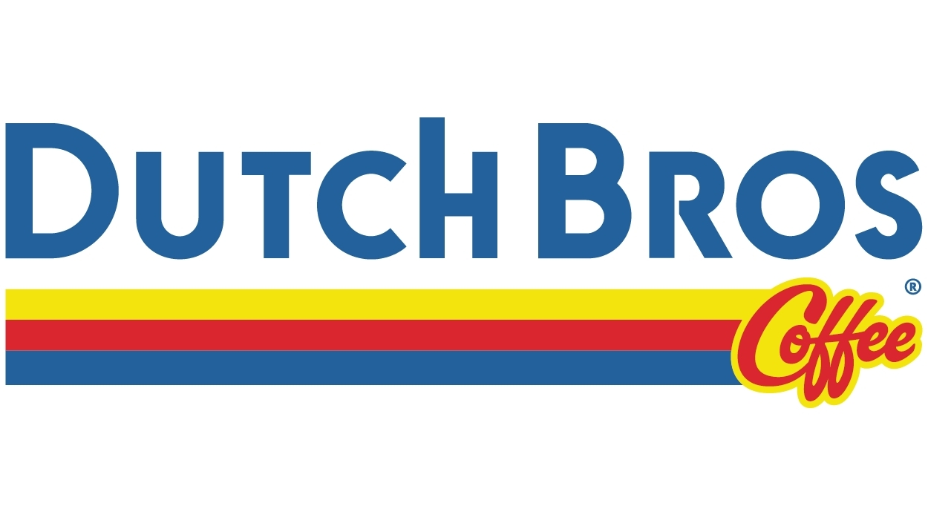
Segmentation Study
Khush Shantilal Domadiya, Alanna Leong, Samantha Nava, Cindy Pantoja, Amisha Farhana Shaik, Jade Vierra

Slide 2
Introduction
The purpose of this research is to identify and profile distinct market segments among Dutch Bros Coffee consumers based on their demographic, psychographic, behavioral, and perceptual characteristics in order to support targeted marketing strategies, brand positioning, and customer retention initiatives.

Slide 3

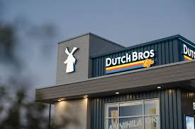
Problem Statement
Dutch Bros Coffee faces a growing challenge in understanding and retaining its diverse customer base.
As competition in the speciality coffee market intensifies, Dutch Bros must go beyond broad demographic targeting to uncover deeper psychographic and behavioral insight
Without clear segmentations, marketing strategies risk being too generalized, missing greater opportunities to connect emotionally with key audiences, strengthen loyalty, and guide future expansion
Notes:
Dutch Bros Coffee has built an incredibly strong brand identity — it’s energetic, community-driven, and especially popular among younger customers.
But as the coffee market becomes more crowded with players like Starbucks, Dunkin’, and boutique coffee brands, the challenge isn’t just about growing — it’s about understanding who their customers truly are.
Right now, Dutch Bros uses broad-based marketing tactics, but their audience is diverse. Some visit daily for convenience, others for the social vibe or creative drinks.
Without deeper segmentation — looking at not just demographics but also psychographics, behaviors, and perceptions — the brand risks missing key opportunities to personalize its strategy and strengthen emotional connections.
Our study addresses this by using marketing analytics and segmentation methods to uncover those hidden customer groups and translate those insights into actionable marketing strategies.”

Slide 4
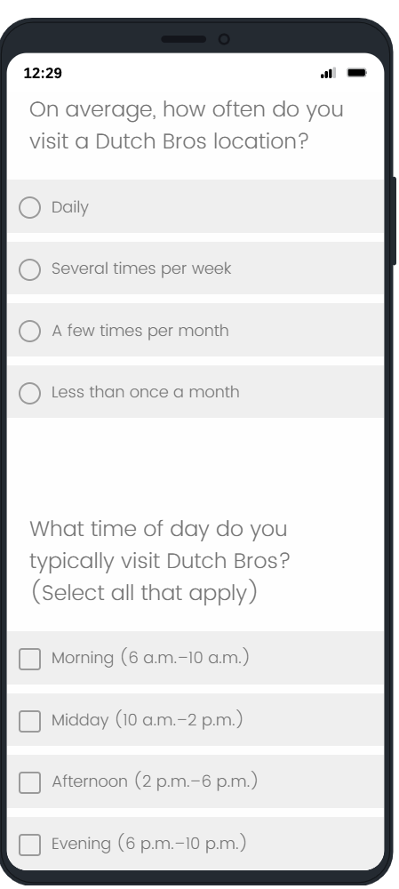
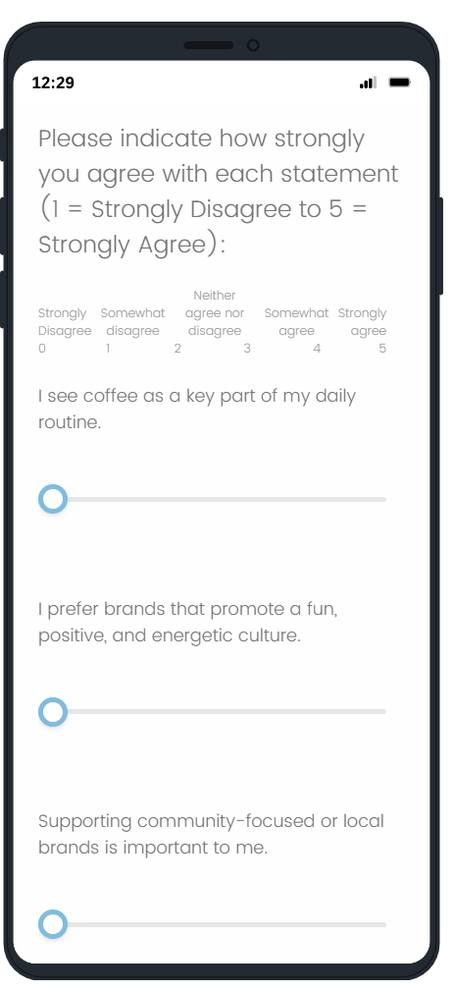
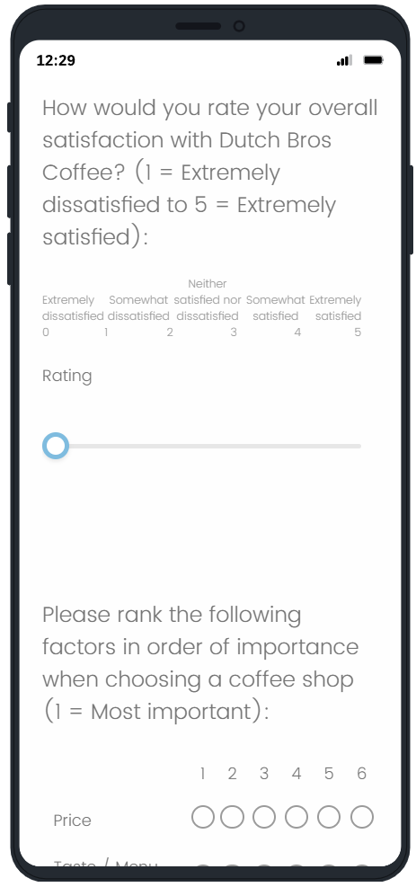
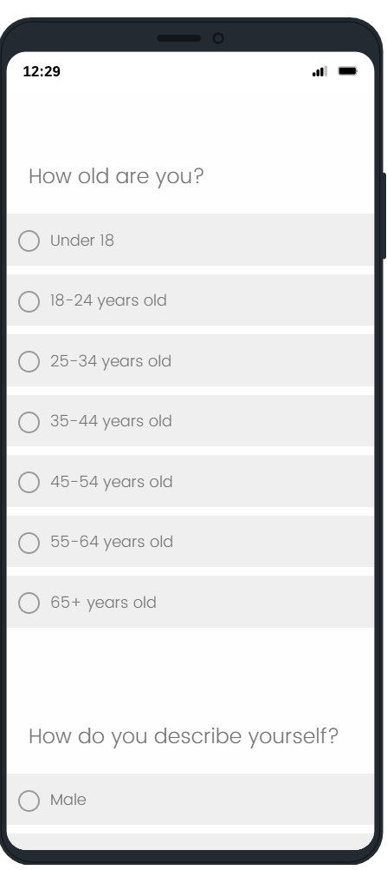

Marketing Segmentation Survey Questionnaire
Coffee Consumption Habits
Brand Perception & Satisfaction
Behavioral Segmentation
Psychographic Segmentation
Demographic Segmentation
Research method
Notes:
Quantitative, survey-based research design
Online questionnaire measuring attitudes, behaviors, and lifestyle traits
Purpose: identify distinct Dutch Bros customer segments
Enabled statistical techniques (clustering + discriminant analysis)
For this project, we used a quantitative survey-based approach to understand Dutch Bros customers. We distributed an online questionnaire that measured consumer attitudes, purchase behaviors, and lifestyle traits. Since this was an exploratory study, we used a convenience sampling method and recruited people who were current or recent Dutch Bros customers through campus and social networks

Slide 5
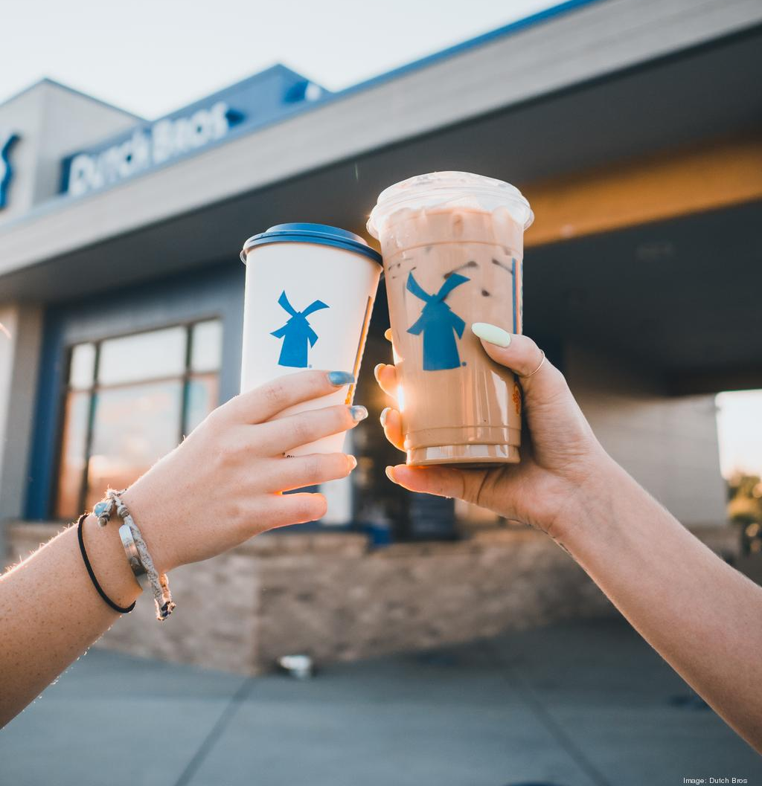

Sampling Method & Size
Online Survey Questionnaire
Non-probability convenience sampling:
•
Respondents recruited through campus networks and social groups
•
Participants required to be current or recent Dutch Bros consumers
•
32 completed surveys collected
•
Sample adequate for segmentation & discriminant analysis
Notes:
We collected 32 usable responses, which gave us enough data to run segmentation analysis. We identified two distinct customer segments, and then applied discriminant analysis to see how observable behaviors and demographics could classify each group. This method allowed us to create segment profiles that are both meaningful and actionable for marketing strategy.

Slide 6


Segmentation Approach
Attitudinal Bases
Descriptors
These variables define why customers differ (The "Core"):
These variables help us find and target them:
Routine: Is coffee a daily habit?
•
Demographics: Age, Gender.
•
•
Brand Personality: Fit with "fun & energetic" culture?
•
Behavioral: Drink Type (Iced vs Hot), Frequency.
•
Channel: Drive-thru vs Walk-up.
•
Community: Importance of local/social connection.
•
Lifestyle: Social, Creative, Busy.
•
Flavor: Willingness to pay for unique items.

Slide 7
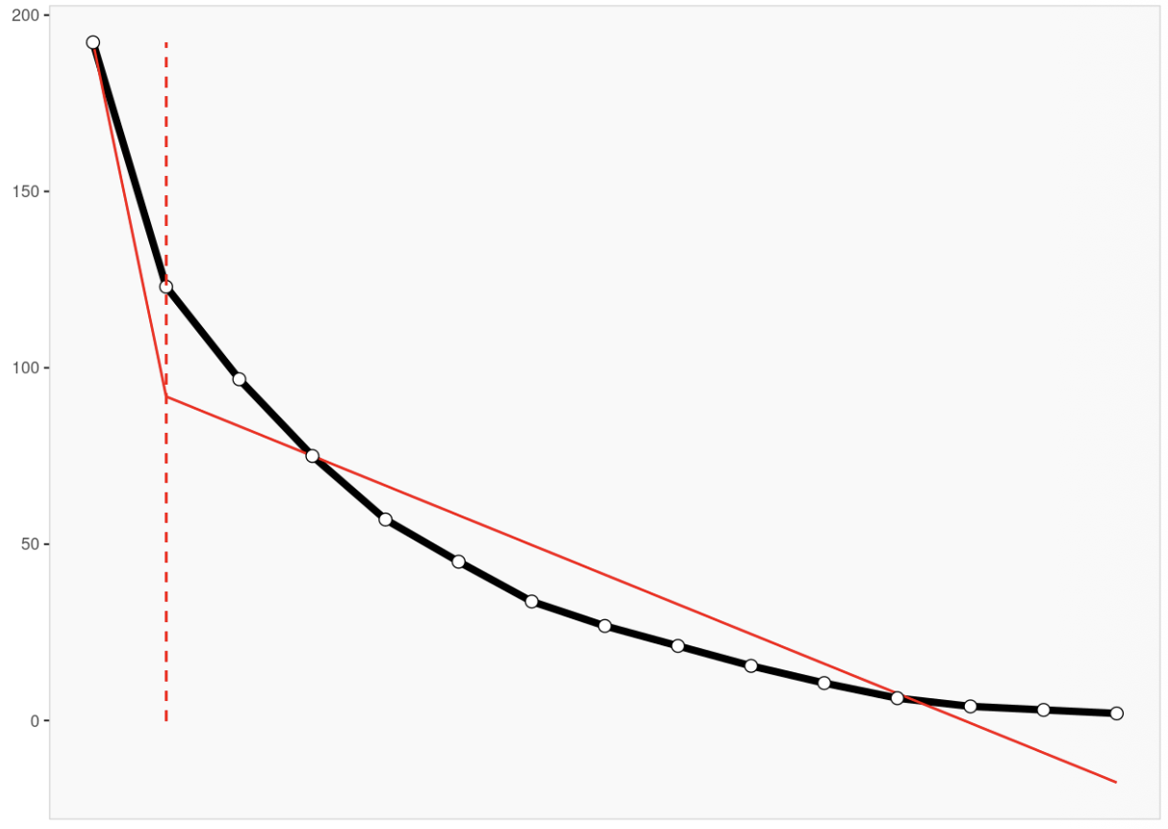
Determining the Segments
From Exploratory to Stable Initial Run: 5 clusters were identified but deemed too small and statistically unstable for practical application. Final Solution: A robust 2-Cluster Solution was validated using Ward's Hierarchical Method. The "Elbow": Visual outputs indicated a clear separation point, making these two groups distinct and 100% classifiable.

Slide 8


Traditionalists
18% of Market
Key Trait: "Low-Engagement"
•
Perspective: Coffee is functional, not emotional.
•
Behavior: Occasional visits, price-sensitive.
•
Preference: Standard hot coffee options.
•
Opportunity: A growth target for convenience-driven value.

Slide 9


Loyalists
82% of Market
•
Key Trait: "Brand-Engaged"
•
Perspective: Coffee is a key part of daily lifestyle.
•
Behavior: Frequent visits, higher spend, socially active.
•
Preference: Iced, blended, and unique energy drinks.
•
Alignment: Deeply connected to the fun, friendly vibe.

Slide 10
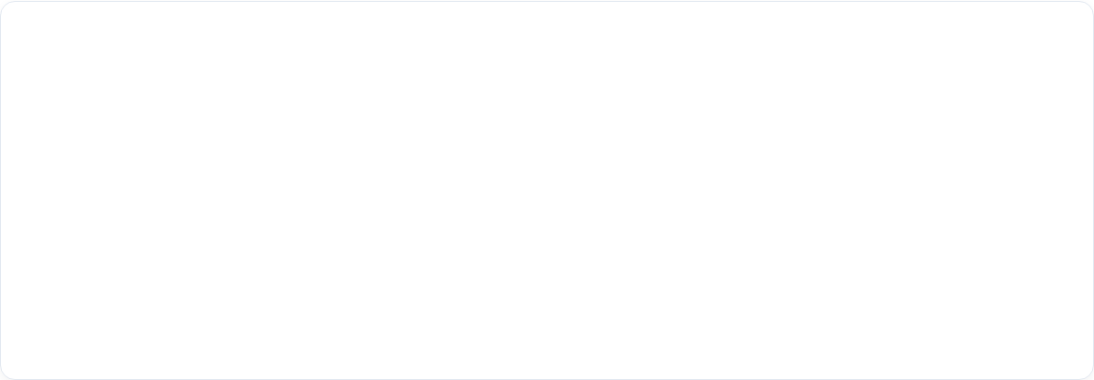
Segment Comparison
Attribute | Low-Engagement Traditionalists | Brand-Engaged Loyalists
Drink Preference | Hot / Traditional Coffee | Iced / Blended / Rebel Energy
Visit Frequency | Occasional (Avg 1.0) | Regular / High (Avg 1.5+)
Motivation | Habit & Convenience | Brand Vibe, Taste & Social
Purchase Method | Walk-up / In-person | Drive-thru / Mobile App
Demographics | Mixed / Older Skew | Younger Professionals / Students

Slide 11
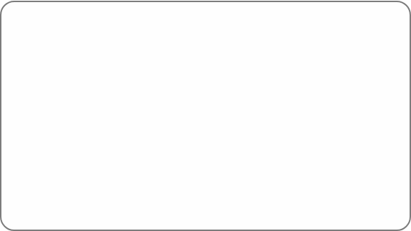



Targeting Strategy
Primary Target: Loyalists
Secondary Target: Traditionalists
Goal: Retention & Advocacy
Goal: Frequency & Conversion
Focus on community events, exclusive app rewards, and "secret menu" drops to deepen the emotional bond.
Leverage speed-of-service messaging and limited-time value offers to turn occasional visits into a habit.
Notes:
Based on our findings, Dutch Bro’s customer base shows two distinct segments:
Strengthen Loyalty Among Brand-Engaged Loyalists (Primary Segment - 82%)
Convert Low-Engagement Traditionalists Into More Frequent Buyers (Secondary Segment – 18%)
We recommend the company to prioritize the primary segment of loyalists and create cross-segment strategies that can also be marketed to the low-engagement consumers as well. We want to build stronger relationships with our consumer base, boost loyalty, and explore new growth opportunities for the Low-Engagement Traditionalists segment.

Slide 12
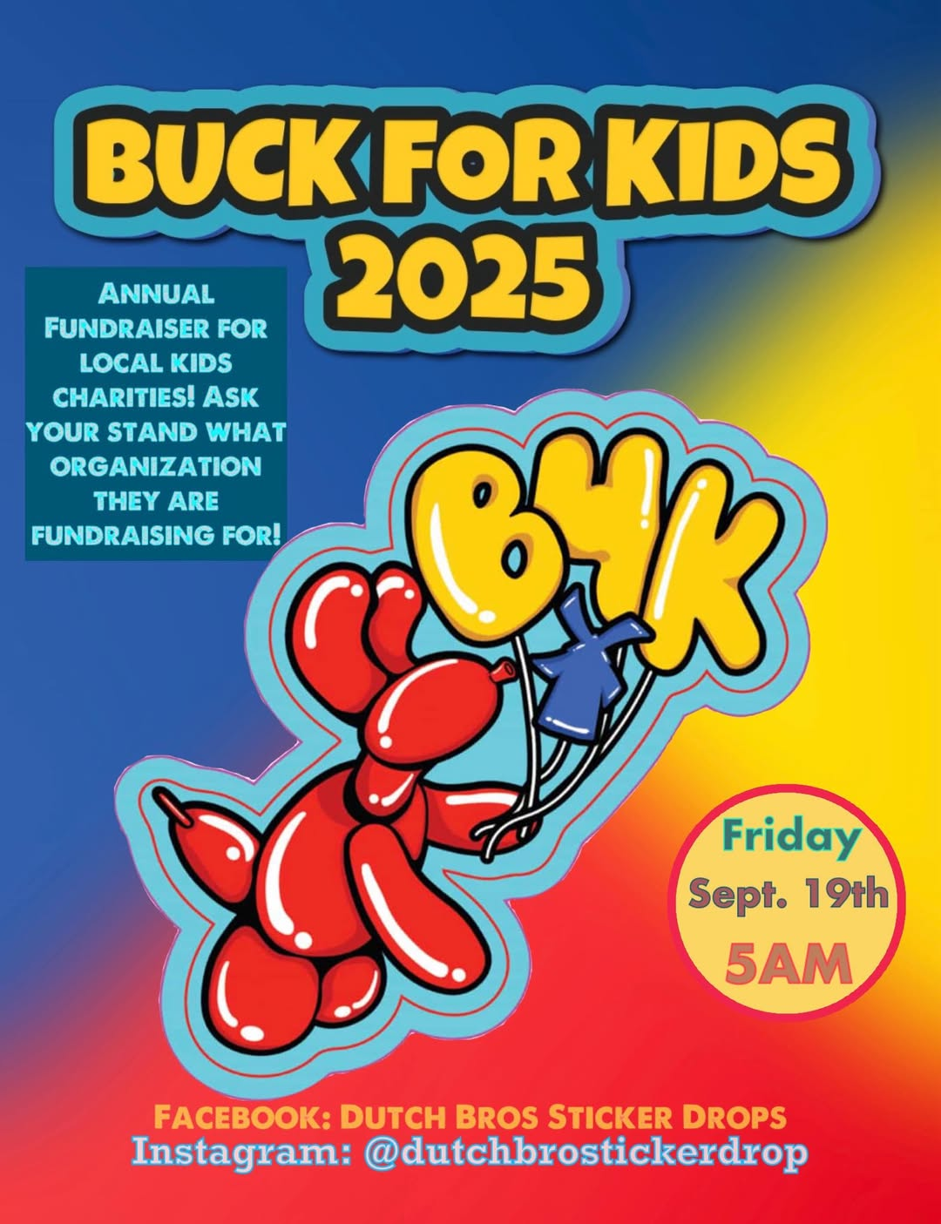
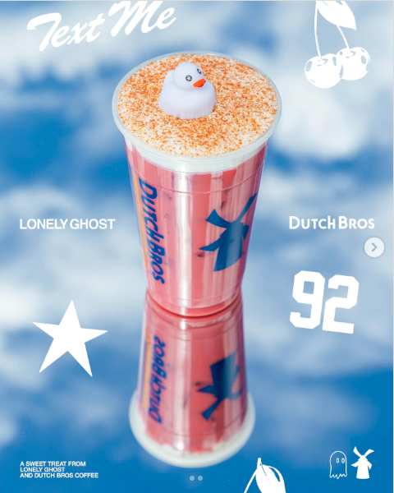
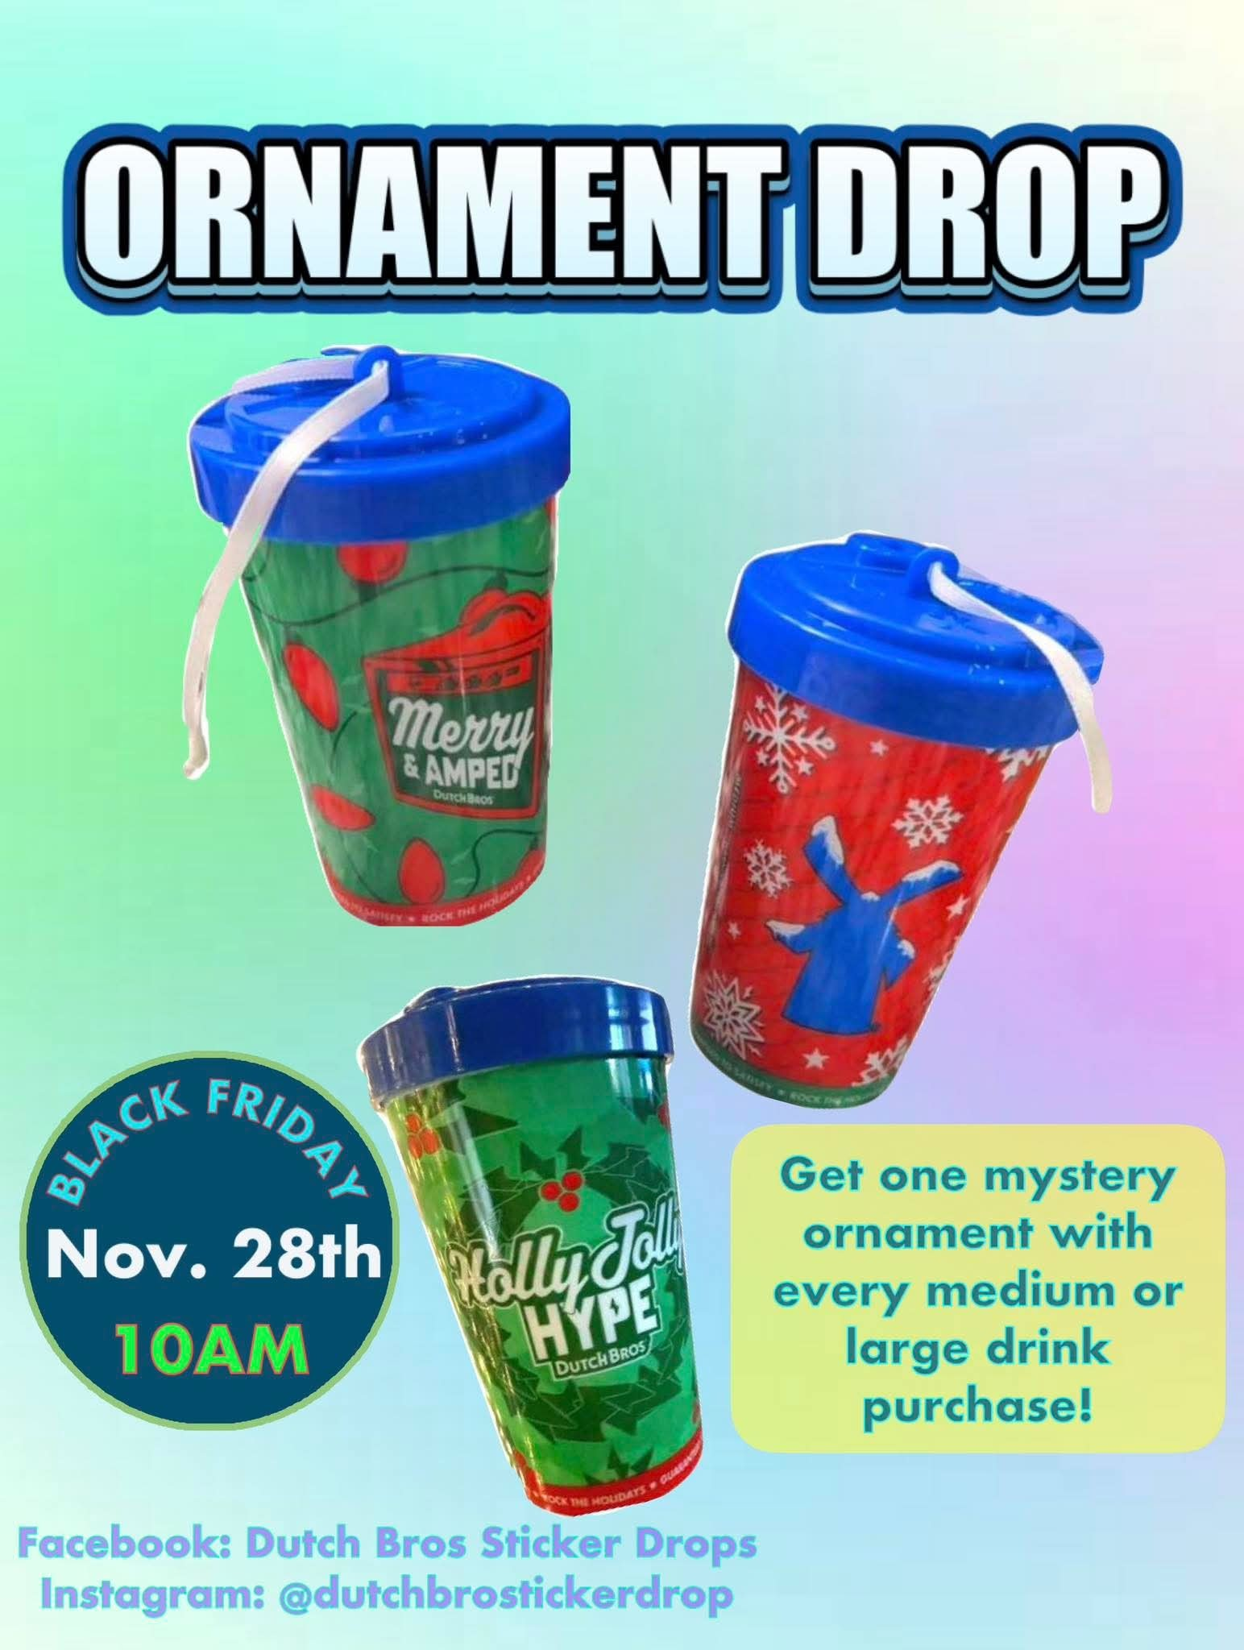
Targeting Strategy: Next steps
Notes:
We want to preserve the existing brand identity
82% of customers already identify with this energetic, friendly culture of Dutch Bro’s. Maintaining this personality is critical to avoid alienating the Loyalists segment that contributes most to revenue and engagement.
•Leverage social media and user-generated content
Create social-driven content that highlights its personality (e.g. community spotlights, fun challenges, drink-of-the-week, and etc) where posts can share on Instagram or TikTok. Both segments appreciate positivity and campaigns like this give loyalists the opportunity to engage with the brand. The brand can partner with and support more causes.
•Offer “Instagram-able” drinks and experiences
Limited-time offerings, collaborations and/or visually striking beverages encouraged for social sharing can energize the brand reinforce why Loyalists feel connected to Dutch Bros. This is a collab with a streetwear brand lonely ghost that came with an exclusive mini duck.
•Build deeper ties through merch and collectibles
Dutch Bros can release limited-edition cups, bottles, or monthly collectible stickers for customers who reach certain visit thresholds. This approach plays into customers’ desire for exclusivity while motivating more frequent repeat visits. They recently released mystery ornaments for the holidays.

Slide 13
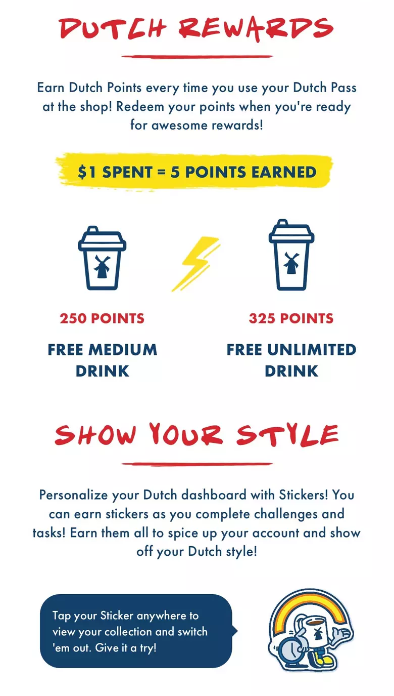
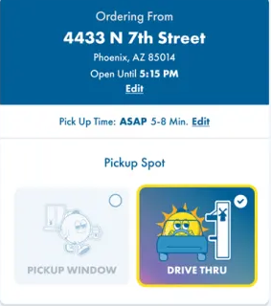
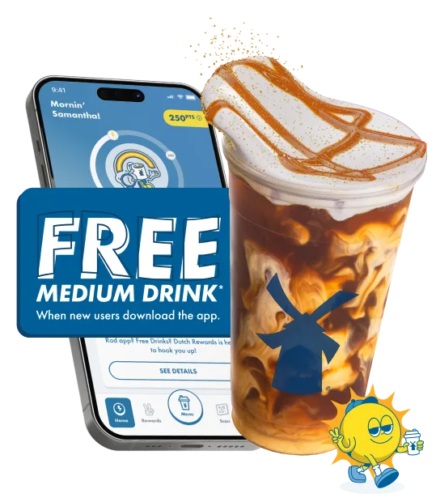
Targeting Strategy: Next steps
Notes:
•Promote convenience through operational improvements
These customers want fast, simple service. Dutch Bros should promote mobile order–ahead features more aggressively and consider designated lanes or faster “simple coffee” lines. Reducing wait times directly addresses the Traditionalist segment’s primary barrier to visiting more often.
Operational benefits: Mobile ordering gives stores more time to prepare drinks and reduces in-line bottlenecks, improving the customer experience for both segment types—especially during peak hours.
•Use value-driven incentives to encourage repeat visits
Because the Traditionalists segment is price-sensitive and behaviorally driven, Dutch Bros should offer compelling rewards—such as occasional free coffees or visit-based perks. Coffee has a high profit margin, so small incentives can be cost-effective while meaningfully boosting visit frequency. The goal is not to change their personality, but simply to encourage more frequent patronage.
Offer app-exclusive discounts or incentives for mobile ordering This encourages Traditionalists through value and convenience, while also appealing to Loyalists who enjoy personalization and digital engagement.

Slide 14
THANK YOU!

